Slide 1
Wel-Come
18425 Vyomkesh Nandkumar Mali
18437 Murlidatt Anil Salgar
18439 Abhishek Sudhakar Sawant
18445 Anup Shankar Zambare

Slide 2
“Wireless Door Lock System”
Android Based Smart door locking system is designed to prevent unauthorized access, trespassing and intrusion.
The purpose of Android Based Smart door locking system is to provide a smart solution to overcome these challenges and provide a feasible solution.
This automatic password based lock system gives user more secure way of locking-unlocking the system.

Slide 3
OBJECTIVE
The goal of this project was to provide an easy and convenient method for unlocking a front door by removing the need for the old-fashioned key. We start by evaluating the need for such a system by sending a survey and analyzing the results.
We follow the Software Development Life Cycle to set the project objectives and implement the design.
Our project helps in building an economical and a low budget biometric lock using the bluetooth available in a smartphone. There are several advantages of the biometric lock

Slide 4
Robbery rate In india past 3 years
Here we can see the robbery rate per year in india, so to avoid these robberies and save our valuable things we can install our designed system and protect our house easily.

Slide 5
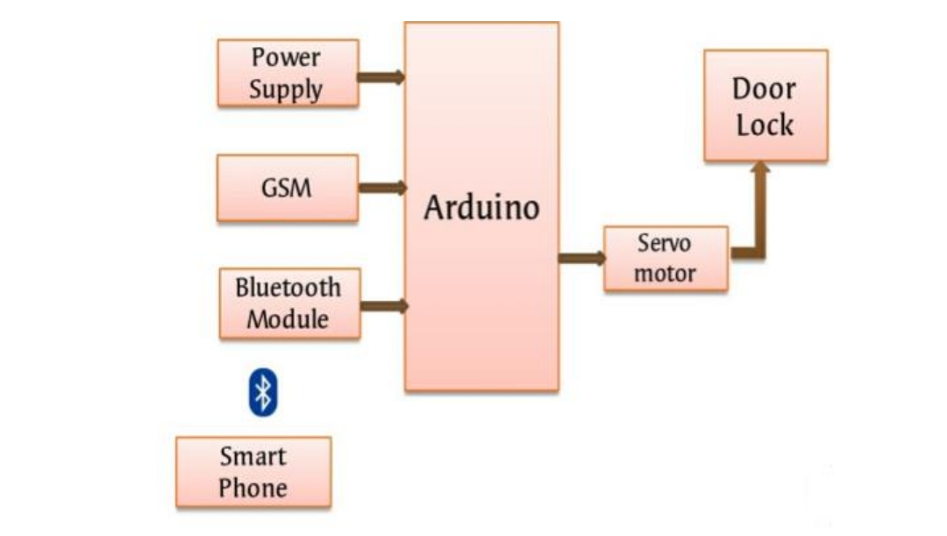
construction

Slide 6
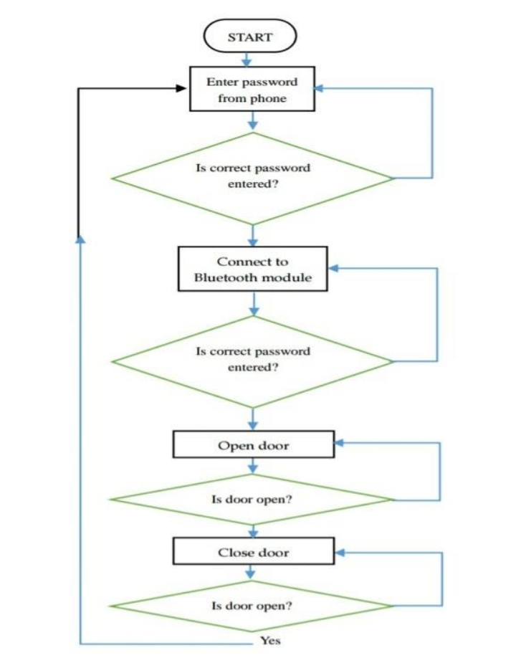
Flow chart of design

Slide 7
Components
Arduino Uno Board
Bluetooth HC-05 module
9V Battery
Jumper Wires 40P
Switch Type: SPST
Solenoid dc lock
MDF Board
Aluminium Tower Bolt

Slide 8
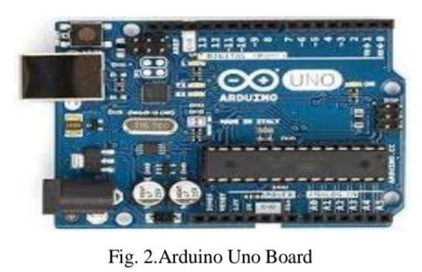

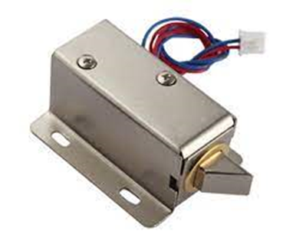
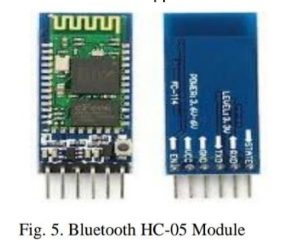
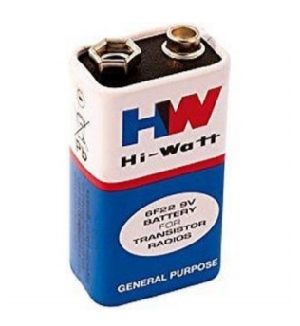
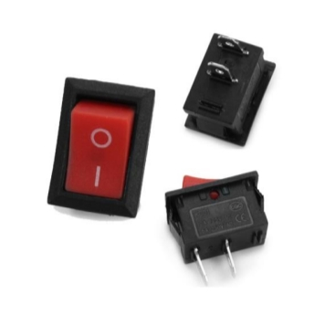

Slide 9
Purpose of the components
Arduino uno: Receives the instruction from Android Apps and process it. Based on the command, it controls the Electric Door Strike.
Bluetooth Module HC05: Bluetooth Module is used for communication channel between Arduino Uno and Mobile Phone.
Android Smartphone: It is used as User interface. User need to install Android Apps which is developed to control the lock and configuring the basic functionalities of the system.
N20 motor: used to open or close the door lock according to the instruction given by the user.
9V Battery: constant power supply.
Jumper Wires 40P: to connect the components with each other.
Switch Type: SPST: to on and of the system.

Slide 10
features
Our project is simple and clean, not so much complicated and understood by everyone.
Less apace consuming, our project requires very less space as it is small in size but very useful.
Our project includes modern techniques and modern components.
Our project is based on the basic requirements of a working man and also a common man.
The components are less and are not costly so anyone can afford it easily.
No any harmful things are used, thus our project is safe and eco friendly.

Slide 11
Pros and Cons
No More Fumbling for Keys. Digging around for your keys in your purse, pocket or briefcase is a hassle.
No Risk of Being Locked Out.
No More Keys Under the Mat.
You Can Track Who's Coming and Going.
You Need to be Diligent.
You Need to Track a Remote Instead of a Key.
You'll Pay More for a Keyless Lock.

Slide 12
SCOPE OF WORK
A rechargeable battery can be provided which can give power backup of 3-4hrs in case of power failure.
For further security, finger scanner, face recognizes oretc can be used.
This system can also be installed with a fire alarm. Usually at home we don't have fire alarms, so this system can work as both - lock and fire alarm.
This system can be used in hotels, banks, motels, or any other place as an alternative lock for additional security.

Slide 13
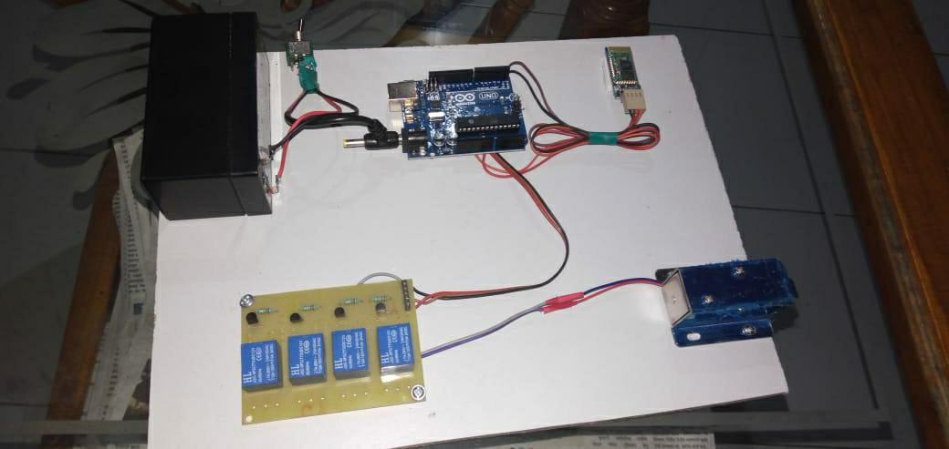
Final look of our project

Slide 14
Conclusion
Thus “Android Based Smart Door Locking System” is a modern successor of the conventional door locking system .This system is very cost effective and easy to install and is designed under different modes which makes it useful.

Slide 15
TOTAL EXPENDITURES
Arduino Uno- 800/-
Bluetooth HC-05- 400/-
9V Battery- 80/-
Jumper Wires- 80/-
Switch Type: SPST- 50/-
MDF Board- 200/-
Aluminium tower Bolt- 100/-
Solenoid lock- 550/-
Other-300/-
Total cost- 2560/-

Slide 16
Thank you

